Slide 1
TA1.1
Multi-domain Design Corpus
TA1.2
Hierarchy of Surrogate Models
Models
Human Response
With OGIS Queries
Learning similarity using
multidomain joint embedding
TA1.3
Contextual Bandit Based Surrogate Model Selector
Oracles: Human + Domain Models + Surrogate Models
Queries
Responses
AG Contract Based Filtering
Oracle Guided Inductive Synthesis
Neurosymbolic Hierarchical Reinforcement Learning
Design Space
Learner
Design Points
Human Guidance

Slide 2
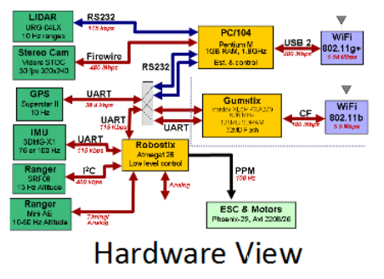
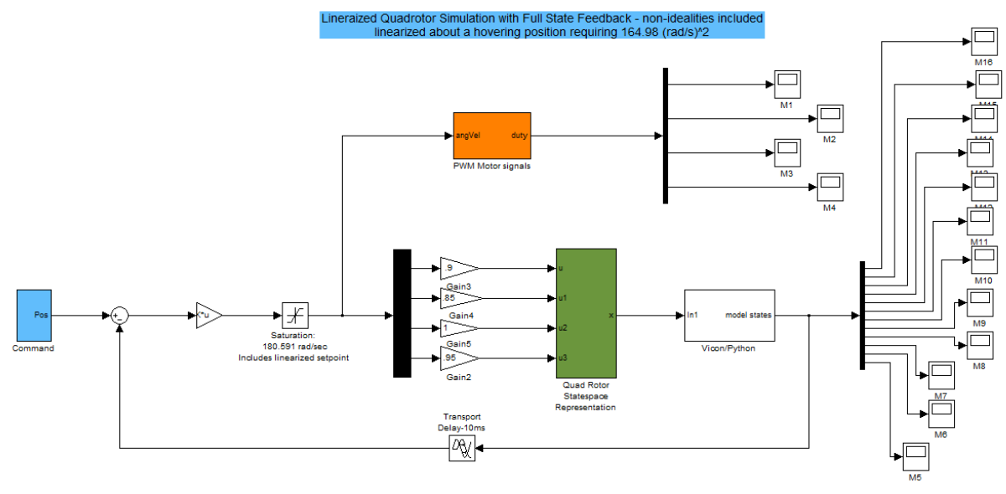
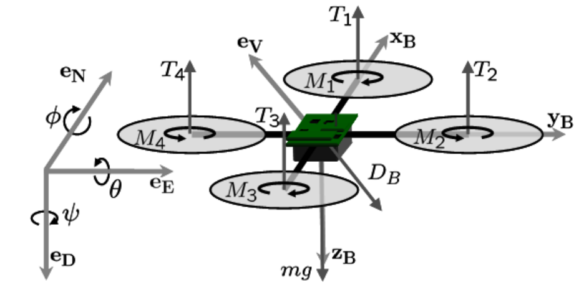
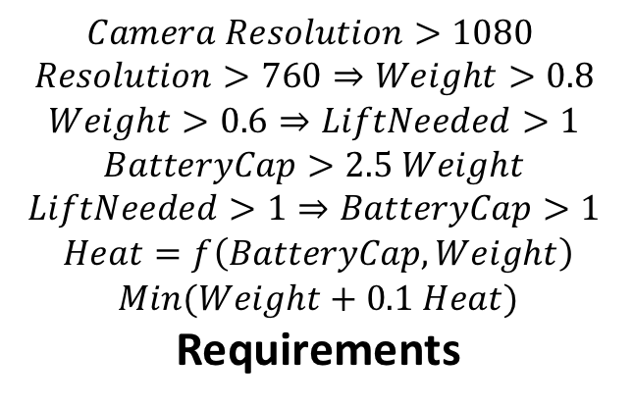
TA3
$$Camera Resolution>1080$$
$$Resolution>760⇒Weight>0.8$$
$$Weight>0.6⇒LiftNeeded>1$$
$$BatteryCap>2.5 Weight$$
$$LiftNeeded>1⇒BatteryCap>1$$
$$Heat=f\left(BatteryCap,Weight\right)$$
$$Min(Weight+0.1 Heat)$$
Requirements
Thermal
Model
Power Model
Control
Model
HW/SW
Model
Structure
Model
Models

Slide 3
TA1.1
TA1.2
TA1.3
Final CPS
Design
(Digital Twin)
with tuned
parameters
Knowledge Bank with Domain-Specific and Cross-domain Design Rules

